Slide 1
Game Development 2A
Data Structures and Big O notation

Slide 2

What is a data structure?
Arrays
Data structures are part of solving a problem
Combine with algorithms for meaningful output
Data structures define how data is stored in memory and can be accessed

Slide 3
Data structures we’ll look at
Stacks
Queues
Linked Lists
Graphs
Trees
Hash Tables

Slide 4
algorithms
Data structures pair with algorithms
01
Traversal
02
Balancing Trees
03
Encryption
04
Compression
05

Slide 5
Types of data structures
Modelling structures
Can be used for modeling real-world problems, like graphs, queues etc.
Efficiency structures
Allows faster/more streamlined operation of code asa a result of structure makeup

Slide 6
Reasons for using data structures
Scene management
Loading
Memory management
Efficiency
AI
Complexity of outcome
Speed
Neural networks
Data structures for physics and collisions
Handled by Unity in some cases
Sometimes you’ll need to deal with it inn your own way

Slide 7
generics
Generics are C#’s equivalent to template classes in C++ or Java
Generic functions
Generic classes
Allows you to define data structures as type agnostic and write code that will make generic comparisons necessary for class operations
You put placeholders as T where you would need to indicate an object type
Reduces code bloat
You don’t have to write differently typed data structures for different scenarios

Slide 8
Big o notation
Describes the theoretical performance of an algorithm
Time
Memory consumption
Comparing an algorithm allows us to compare it to other similar algorithms
Standardises the measure of efficiency

Slide 9
Big o notation
Algorithm A faster than B for lists < 1000 items
Is A faster?

Slide 10
Big o notation
We measure algorithmic complexity as a measure of time
O(1) refers to a single action
Insertion is O(1) because insertion happens and that’s it
Searching through a list of 10 items?

Slide 11
Big o notation
O(10)
O(N) because it depends on the number of items and can realistically run up to N times
Consider binary search – the ordered list shrinks in half every time you find the correct side of the list

Slide 12
Big o notation
O (log N)
10 item list has log 10 of 1, 20 items is 1.3
More efficient

Slide 13
Algorithmic complexity
O(1) – fastest
1
O(log N) – reasonably fast
2
O(N) – slower
3
O(N^2) – very slow
4

Slide 14
collections
These data structures can be seen as collections
Collections are structures that support a variety of operations
Adding
Updating
Deleting
CRUD

Slide 15
collections
Linear
Ordered by position
Accessed by position
Direct access
Sequential access
Non-Linear
No positional order
Some hierarchical structure based on the structure
Hierarchical access
Grouped access

Slide 16
collections
Add
01
Remove
02
Count
03
Contains
04
Clear
05
IndexOf
06

Slide 17
Linear access collections
Arrays
Strings
Easy to place/delete an element at the end, because we’ll always know where the end is
Harder to insert of delete elsewhere because then we need to rearrange items around that new value

Slide 18
Sequential access
Lists
Not limited in size
Has a start and an end
Can be ordered or unordered
Runs from first item to last item
FIFO

Slide 19
Stacks and queues
List that limit to first/last data structures
Stack
LIFO
Added to rear, removed from rear
Pushing to a stack and popping off a stack
Queue
FIFO
Added to rear, but removed from front
Enqueue and Dequeue

Slide 20
Hash tables
Take a full record
Compute some sort of value based on that record that is used for access
Primary Key in Databases

Slide 21
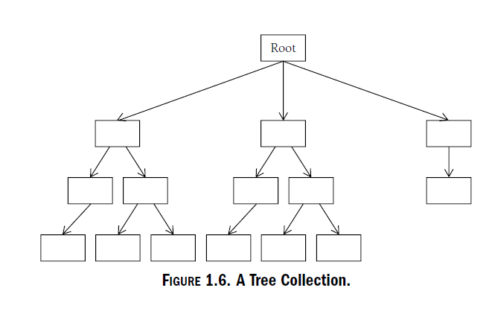
Hierarchical collections
Trees
One root, multiple paths with multiple children
Binary tree – each node has max 2 children
Good for searching – data can be organized along the shortest possible path
Heap trees – smallest data at root

Slide 22
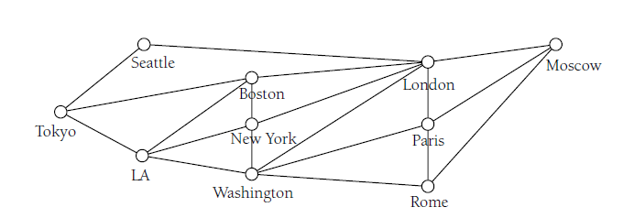
graphs
Sets of nodes and sets of edges
Best way to traverse
Logistics and Job Scheduling
Can provide weighting for each edge to signify shortest paths
Dijkstra’s Algorithm

Slide 23
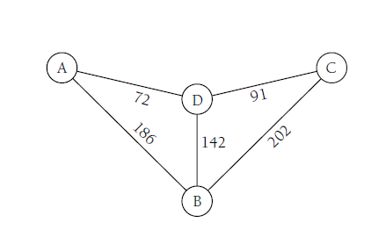
Weighted graphs

